Slide 1




𝖣𝖠𝖳𝖠𝖲𝖤𝖳’25
ECDS
Uppoo
TEAM NAME: 405 FOUND

Slide 2
𝖣𝖠𝖳𝖠𝖲𝖤𝖳’25
ECDS
Problem Statement:
INTERACTIVE THERAPY AUTHORING STUDIO WITH CULTUARALLY ADAPTED TOOLS & RESOURSE MARKETPLACE

Slide 3
𝖣𝖠𝖳𝖠𝖲𝖤𝖳’25
ECDS
IMPACT VISION:
The existing solutions for therapy for behavioral issues are western centric content, and this is the gap we aim to bridge along with the culturally resonant visuals of India.

Slide 4
𝖣𝖠𝖳𝖠𝖲𝖤𝖳’25
ECDS
Our platform aims to reduce the professional’s workload, destigmatize therapy, and expand access to high-quality digital therapy tools across India, empowering both professionals and families.

Slide 5
𝖣𝖠𝖳𝖠𝖲𝖤𝖳’25
ECDS
USP
Parents/Caregivers get a separate login
Monitor child progress
View assigned tasks & reports

Slide 6
𝖣𝖠𝖳𝖠𝖲𝖤𝖳’25
ECDS
OUR SOLUTION:
An Interactive Therapy Authoring Studio with:
• Parent/Caregiver Monitoring
• Activity Creation
• Offline-first access

Slide 7
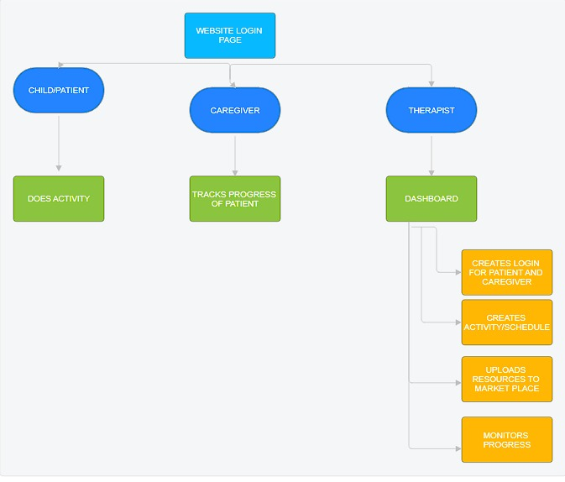
𝖣𝖠𝖳𝖠𝖲𝖤𝖳’25
ECDS
WORKFLOW DIAGRAM WITH TECH STACK:
BACKEND – NODEJS
TYPESCRIPT-FEATURES
VITE-SERVER
DBMS-SUPBASE

Slide 8
𝖣𝖠𝖳𝖠𝖲𝖤𝖳’25
ECDS
Preethi Ramesh – 24BCE5526
Priyadarshini Palanirajan – 24BCE5572
Bhaskar Reddy-24BPS1094
Hrushikesh-24BAI1216

